Slide 1

EVENT BUBBLING

Slide 2
Event Bubbling
events ripple and affect a bunch elements that lie in their path

Slide 3
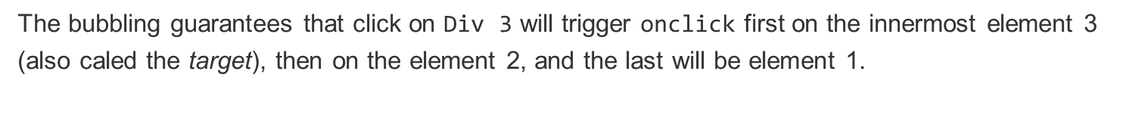
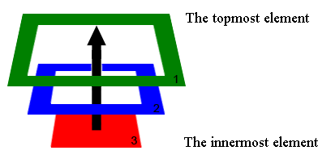
Event Bubbling

Slide 4
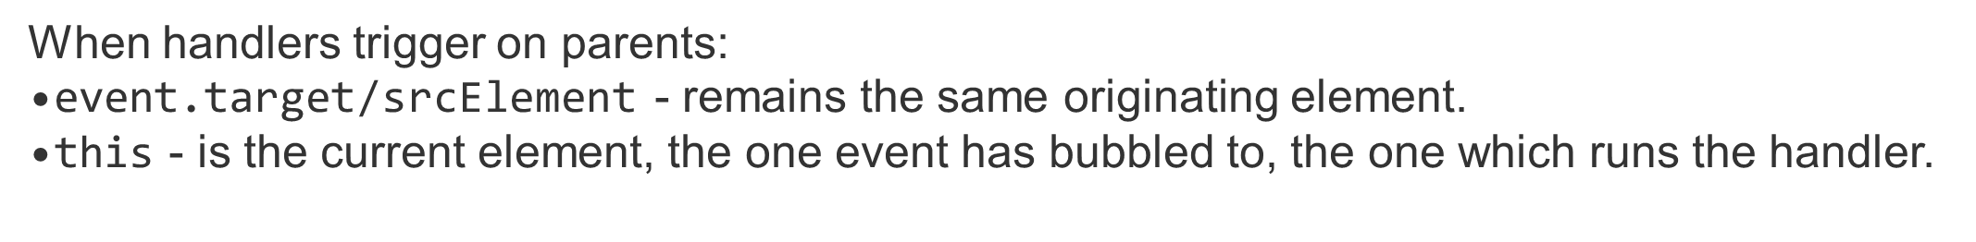
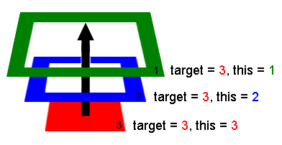

Slide 5
<body id="theBody" class="item">
<div id="one_a" class="item">
<div id="two" class="item">
<div id="three_a" class="item">
<button id="buttonOne" class="item">one</button>
</div>
<div id="three_b" class="item">
<button id="buttonTwo" class="item">two</button>
<button id="buttonThree" class="item">three</button>
</div>
</div>
</div>
<div id="one_b" class="item">
</div> </body>

Slide 6
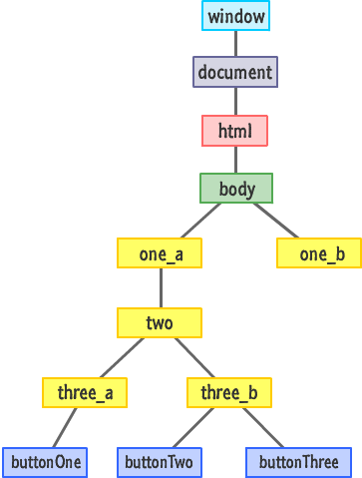

Slide 7
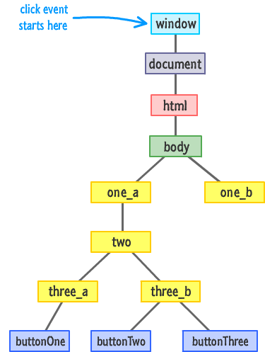

Slide 8
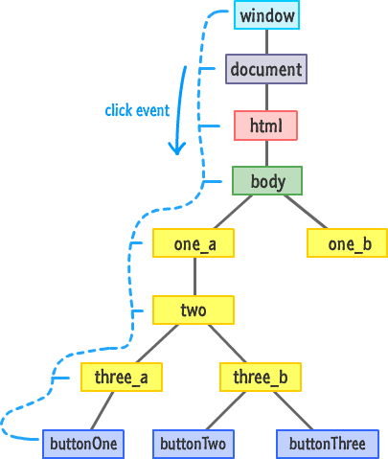

Slide 9
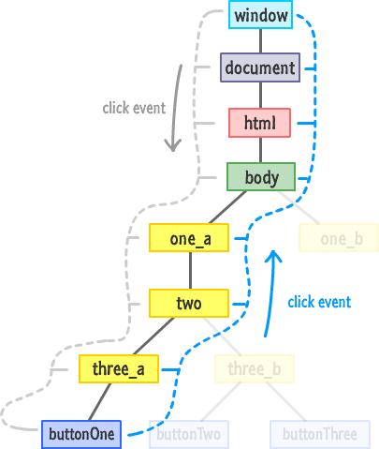

Slide 10
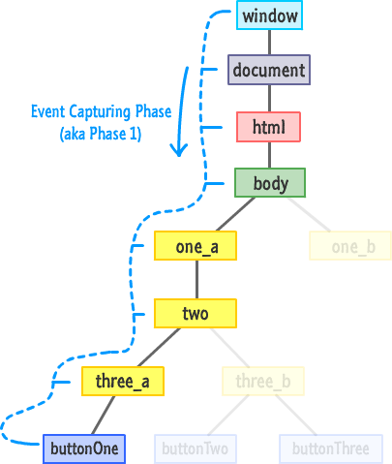

Slide 11
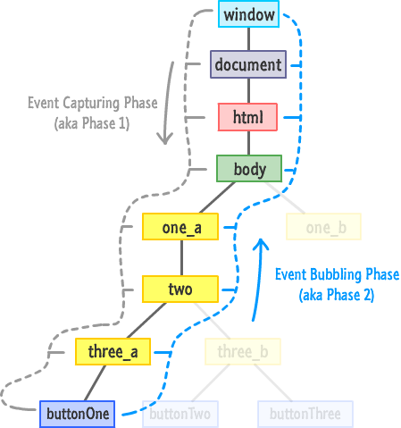

Slide 12
Event Properties and MethodsProperty/Method
Descriptionbubbles Returns whether or not a specific event is a bubbling event.
cancelBubble Sets or returns whether the event should propagate up the hierarchy or not
cancelable Returns whether or not an event can have its default action prevented
composed Returns whether the event is composed or not
createEvent() Creates a new event
composedPath() Returns the event's pathcurrent
Target Returns the element whose event listeners triggered the event
defaultPrevented Returns whether or not the preventDefault() method was called for the even
teventPhase Returns which phase of the event flow is currently being evaluated
isTrusted Returns whether or not an event is trusted
preventDefault() Cancels the event if it is cancelable, meaning that the default action that belongs to the event will not occur
stopImmediatePropagation() Prevents other listeners of the same event from being called
stopPropagation() Prevents further propagation of an event during event flow
target Returns the element that triggered the event
timeStamp Returns the time (in milliseconds relative to the epoch) at which the event was created
type Returns the name of the event

